Slide 1
British Airways Data Science Virtual Experience
Task 1
Submission by:
Anu Mishra
GitHub: anumishra10

Slide 2
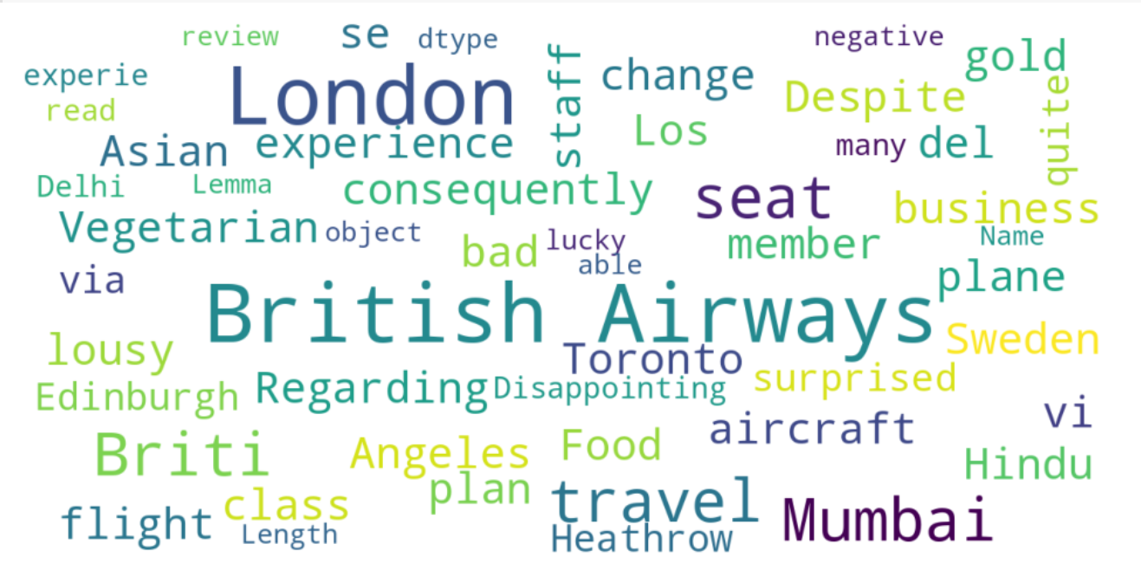
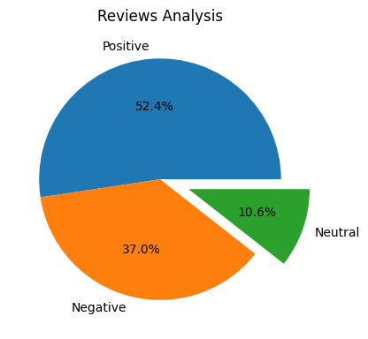
Following are the insights from 1000 user reviews on the website
Positive 524
Negative 370
Neutral 106
The words that came frequently in the reviews are:-

